Slide 1
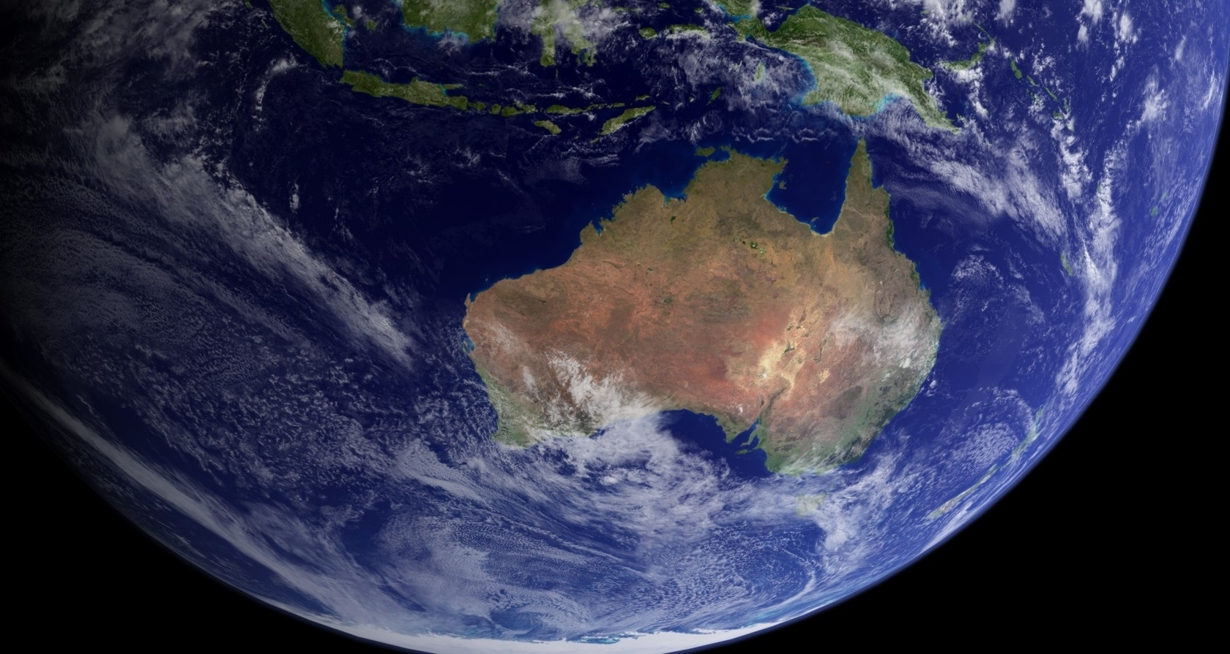
ACCESS – Australia’s national weather and global climate model system
Climate modelling
Tony Hirst | Earth System Modelling
CSIRO Oceans and Atmosphere

Slide 2
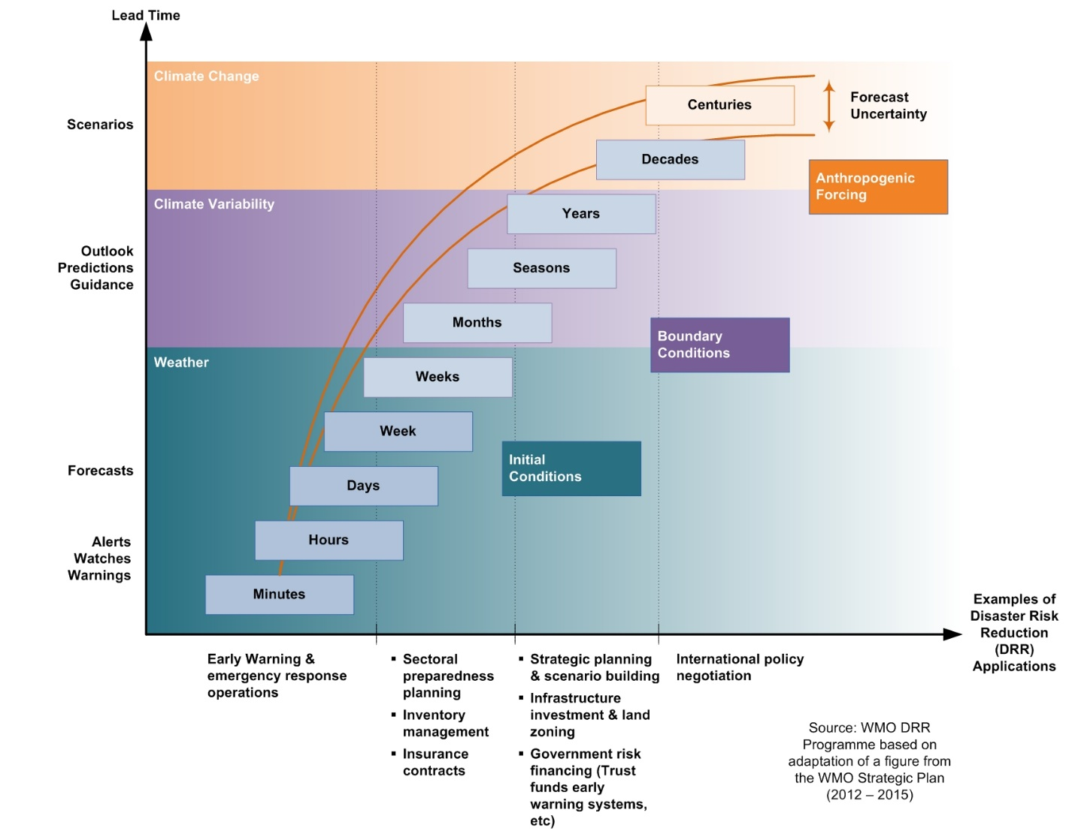
The ACCESS Modelling Program
Provide a national approach to climate and weather prediction model development
Joint initiative
Bureau of Meteorology
CSIRO
Australian universities
Strong international collaborations
Met Office
GFDL
This talk – the longer time scales
Decadal prediction
Multi-decadal projections
Climate – carbon cycle and atmospheric chemistry feedbacks
Notes:
Aims to support research and applications across a range of time scales:
Numerical weather prediction through climate change projection

Slide 3
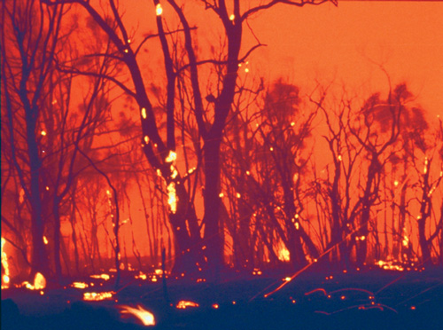
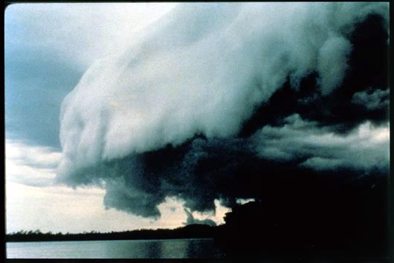
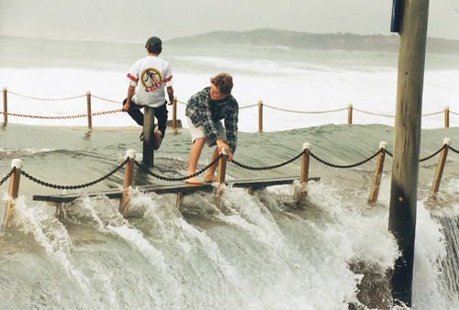
Motivation:
Climate parameters are changing
Australia’s climate is dominated by drought and flood cycles and a range of high impact weather
How will these change?
Emissions policy is tightening
Independent modelling capability to explore these challenges
Independent contribution towards global solutions including modelling contributions to support the IPCC process
Notes:
Often with substantial human, social, environmental and financial costs

Slide 4

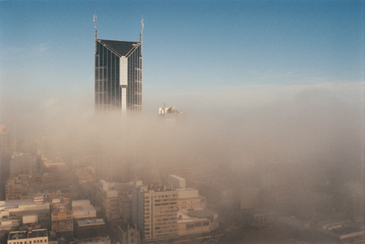

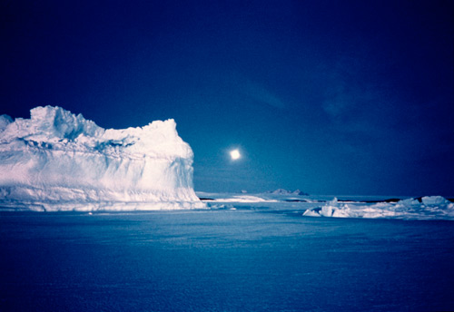
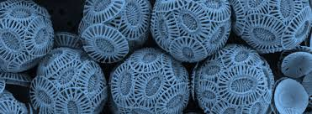

ACCESS: Earth System Model
Atmospheric chemistry
UKCA
Atmosphere
UM
Coupler
OASIS – ocean/atm/sea-ice
JULES framework
Terrestrial
CABLE
Terrestrial Carbon
CASA-CNP
Ocean bgc
WOMBAT (Matear et al.)
Ocean: GFDL MOM
Sea-ice: LANL CICE

Slide 5
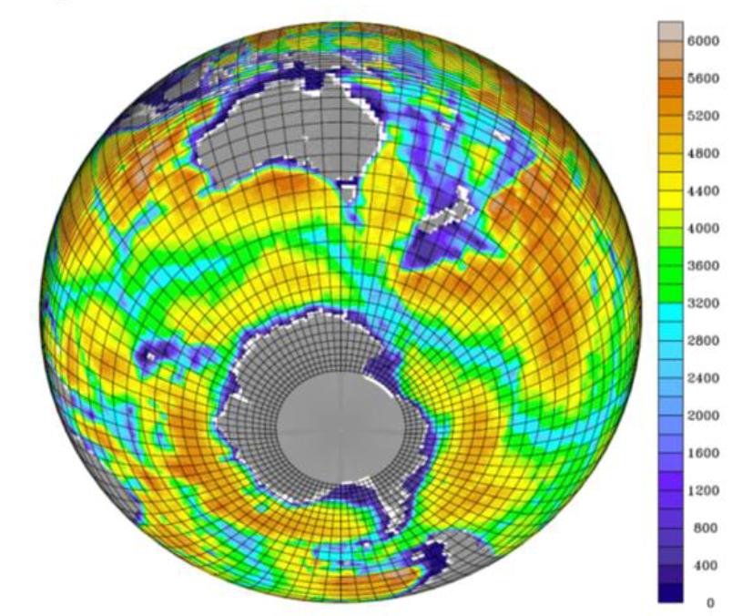

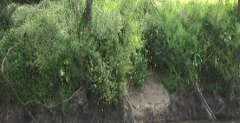
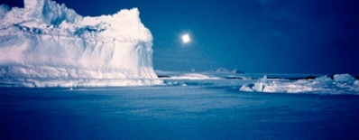
ACCESS: Global climate modelling
ACCESS1: First ACCESS coupled climate model
Atmosphere
Met Office UM7.3 + CAWCR mods
Terrestrial
CABLE1.8
or MOSES2
Coupler
OASIS3
Bathymetric depth (m)
Ocean
and sea-ice
MOM4p1 and CICE4
Ocean and sea-ice
Atmospheric resolution
~130 km horizontal “N96”
38 levels vertically
Ocean component grid and bathymetry
(showing every 4th grid row zonally and meridionally).

Slide 6
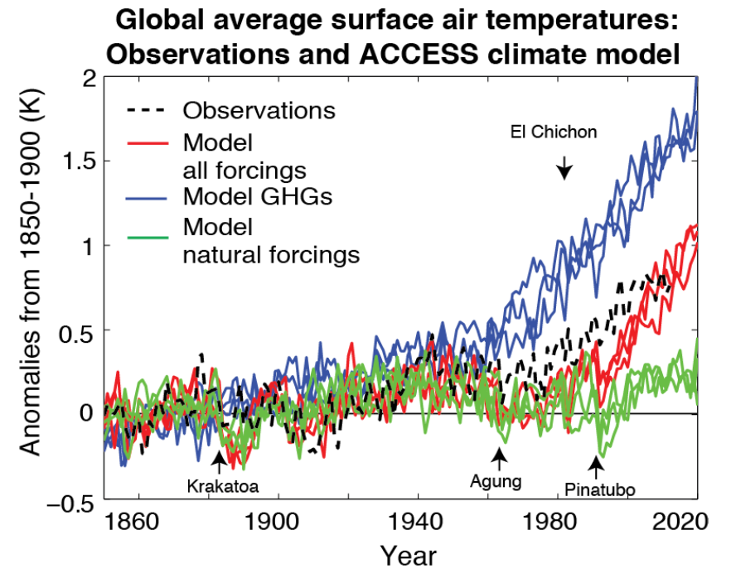
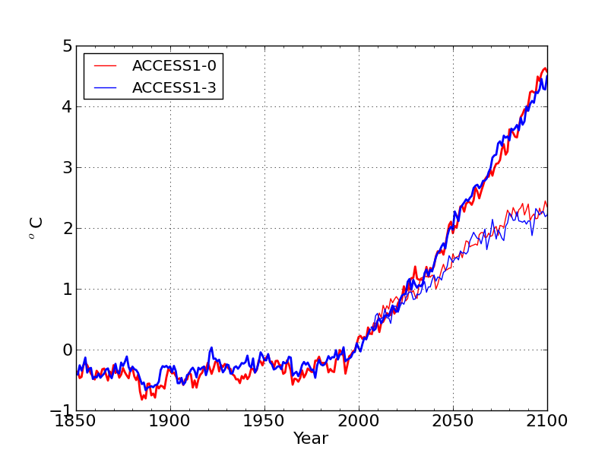
ACCESS Climate Model – Simulations to contribute to IPCC 5th Assessment Report and CMIP5
CMIP5 model versions
ACCESS1.0 and ACCESS1.3
Differ in land surface model
Differ in atmospheric physics (esp. cloud)
CMIP5 simulations
CORE experiments
Historical ensembles, RCP simulations
Output published on Earth System Grid (NCI node)
ACCESS – RCP4.5 and RCP8.5
Collaboration between CSIRO, Bureau and ARCCSS
Surface air temp
anomaly (°C)
Computing done on NCI
Supported by the ACCSP
Notes:
Instead include figures from Australia!

Slide 7
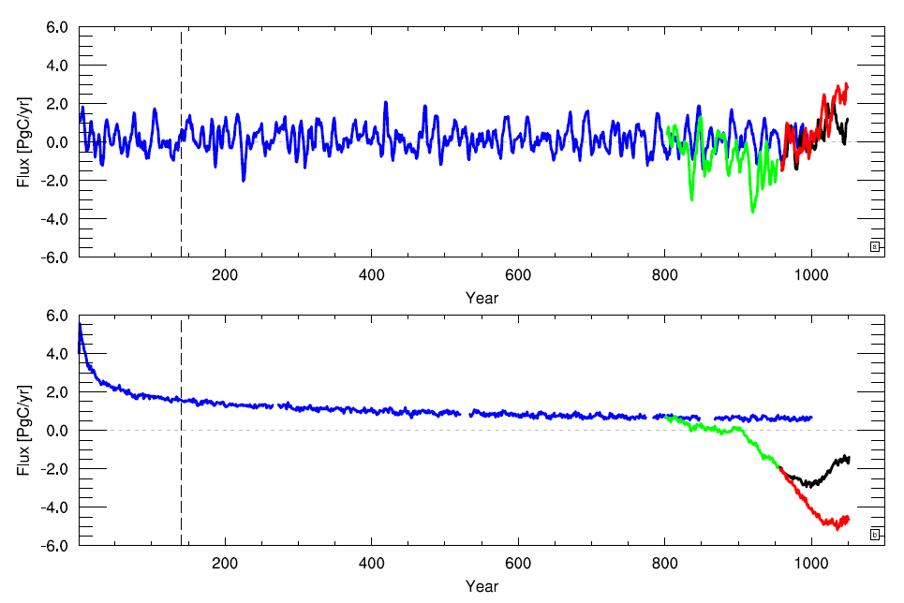
ACCESS-ESM1 First ACCESS Earth System Model
CO₂ flux to atmosphere
(prescribed atmospheric CO2 concentrations)
Based on improved version of ACCESS1.3
Includes ocean and land carbon cycle
Simulations (prescribed CO2)
1000 yr pre-industrial (blue)
Historical (green)
Future scenarios:
RCP4.5 (black); RCP8.5 (red)
Also an emissions driven set
‘Workhorse’ model for ESM science for near future
Land carbon exchange
Ocean carbon exchange
Model Year
Law et al., Geosci. Model Dev. Discuss., 2015; Ziehn et al., Geosci. Model Dev. Discuss., submitted.
Notes:
Moving to our current systems…..
Can be used to address many questions in the carbon-climate feedback area

Slide 8
ACCESS-ESM1 – some limitations:
Issues with tropical variability (ENSO, IOD, intraseasonal)
Issues with aerosol radiative forcing
Vertical and oceanic resolution inadequate for some applications
UM community moving to new atmospheric models “GA6” and “GA7” (Partner interest in up-to-date physics!)
Development of ACCESS-CM2/ESM2 underway
8
Notes:
Atmospheric code becoming out of date

Slide 9
ACCESS-ESM1 and ACCESS-CM2/ESM2
 | ACCESS-ESM1 | ACCESS-CM2/ESM2
Atmospheric code | UM7.3 | UM10.x
Atmospheric physics | UM7.3 default (e.g., PC2 cloud) + CAWCR mods (pre-GA1) | GA7 (pending – interim GA6)
Atmospheric resolution | Horizontal: N96 (~130 km) Vertical: 38 levels | Horizontal: N96 and N216 (~60 km) Vertical: 85 levels
Atmospheric chemistry | None | UKCA
Land surface model | CABLE2 | CABLE2 (pending – interim JULES)
Terrestrial biogeochemistry | CASA-CNP | CASA-CNP
Ocean model | Modular Ocean Model (MOM5). | MOM5.1
Ocean resolution | Horizontal: 1 deg lat/lon (enhanced tropics and polar) Vertical: 50 levels | Horizontal: 1 deg lat/lon (enhanced tropics and polar) and 0.25 deg lat/lon Vertical: 50 levels
Sea ice model | CICE5 | CICE5.1
Ocean biogeochemistry | WOMBAT | WOMBAT

Slide 10
Prototype ACCESS-CM2 now running
Currently has GA6 atmosphere
Currently has Jules land surface model
Three versions – different horizontal resolution
Resolution | Atmosphere | Ocean | Trial Simulation completed | Computing
Standard “N96O1” | N96 (~130 km) | 1 deg. | 200 years | 496 cores, 5 y/d
Mixed “N96O.25” | N96 | 0.25 deg. | 300 years | 2112 cores, 6 y/d
High “N216O.25” | N216 (~60 km) | 0.25 deg. | 2 years | 2688 cores, 1.5 y/d
Strong collaboration with ARCCSS and Bureau in high-res ocean (“O.25”) versions
10
Notes:
GA6 “Global Atmosphere 6” includes many improvements over that used in ACCESS1.3 which was approx GA1, notably a new dynamical core “ENDGAME”.

Slide 11
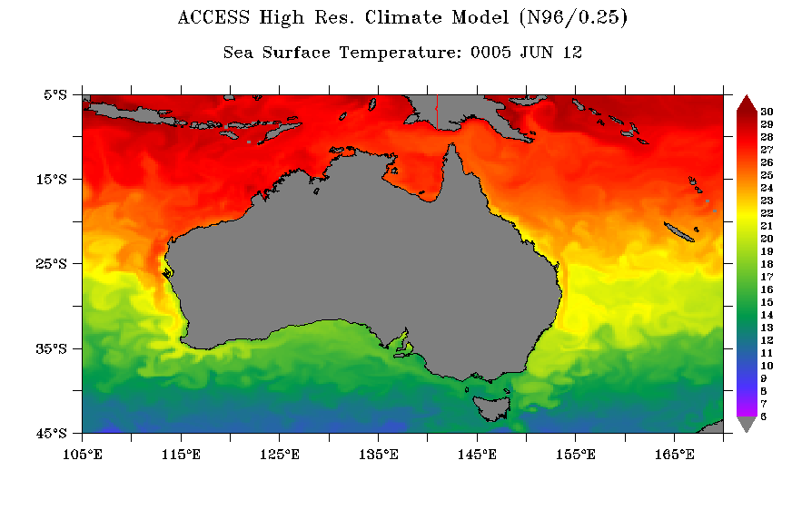
SST snapshot – ACCESS-CM2
Version N96O.25 – 0.25 deg ocean

Slide 12
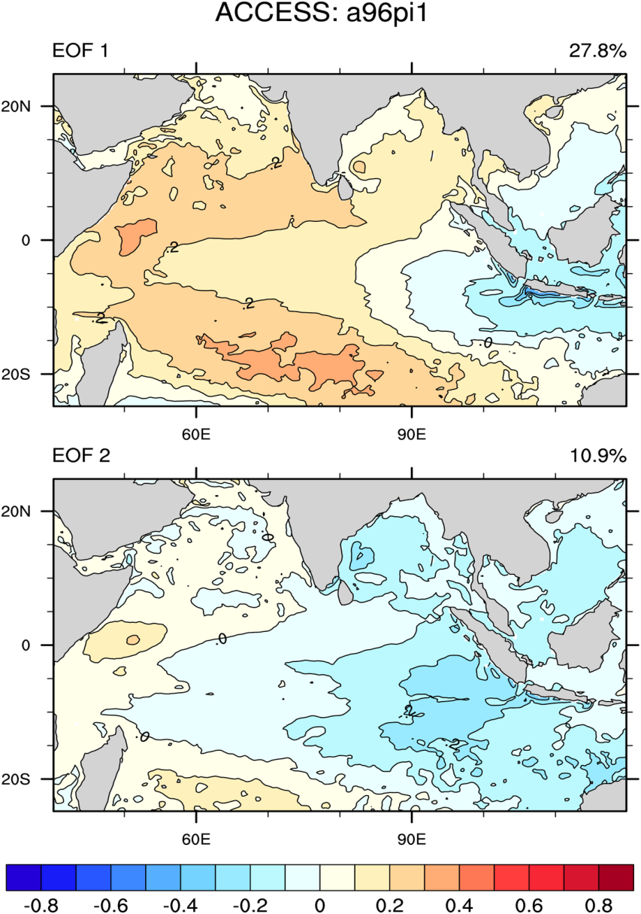
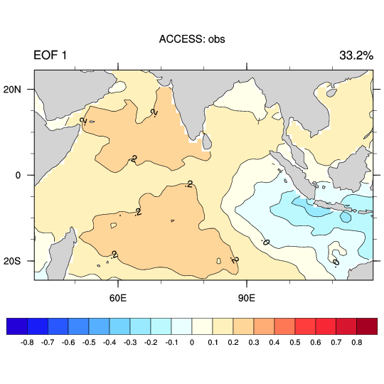
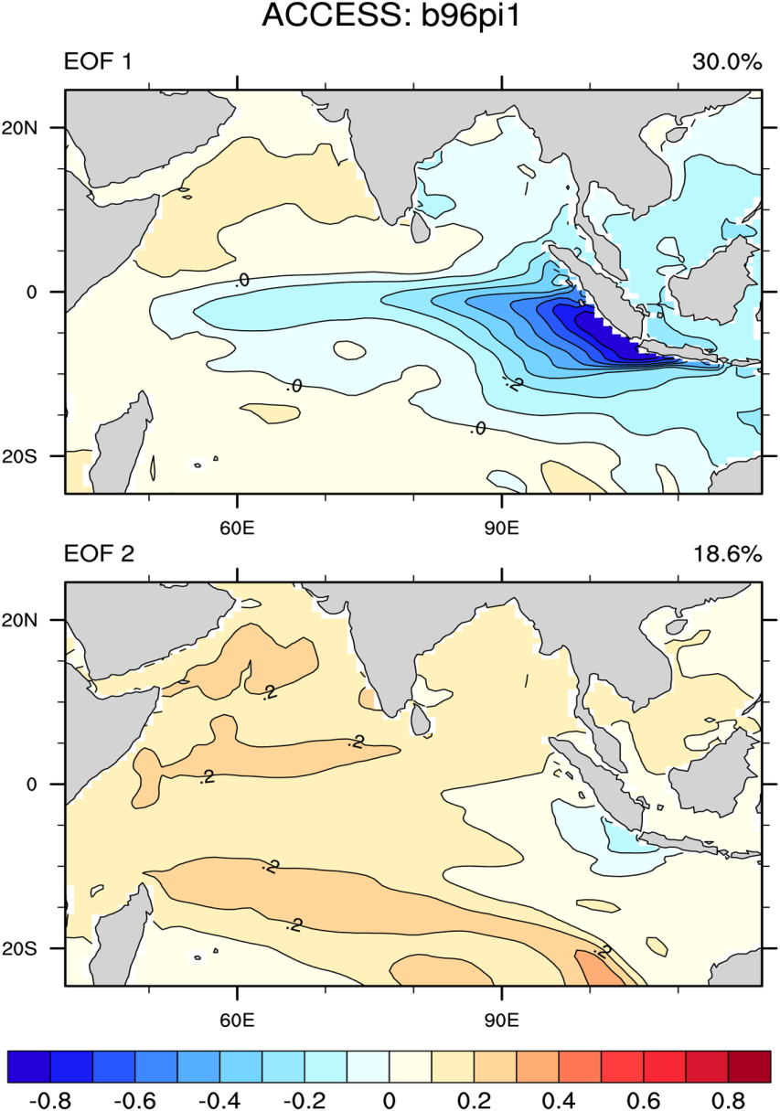
Indian Ocean Dipole (SON) ACCESS-CM2
(years 101-200)
N96O.25 version
HadISST (yrs 1950-2014)
– IOD
N96O1 version
Notes:
While ENSO behaviour is comparable, that for the IOD is very different.

Slide 13
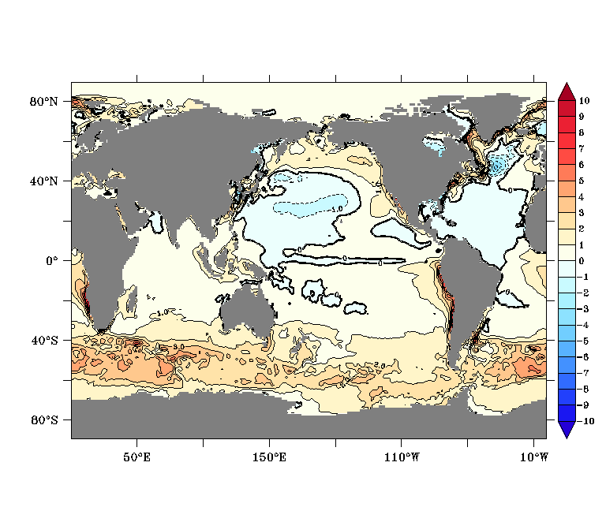
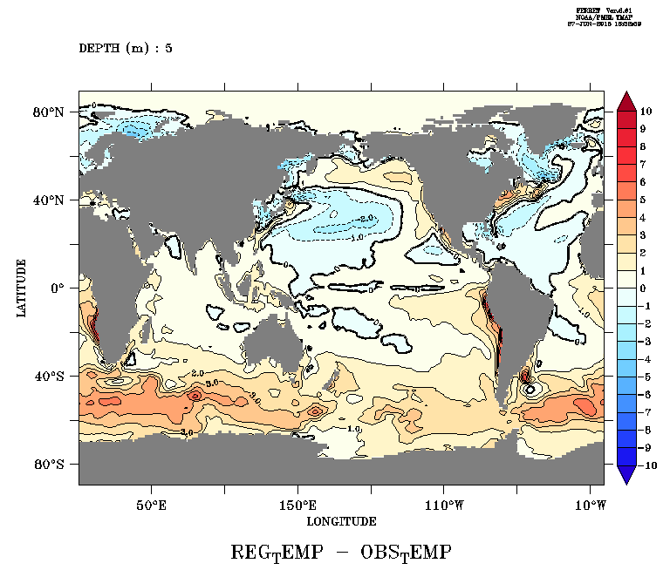
SST Bias – ACCESS-CM2
N96O.25 version
N96O1 version
(years 151-200)
Southern Ocean warm bias due to cloud/radiation biases
Is common to models based on GA6 atmosphere

Slide 14
GA7 model configuration
Implemented at NCI with 10-year trial simulation performed.
GA7 includes a range of improvements, most notably the new GLOMAP aerosol scheme (has much more physical treatment of mixed aerosol optical properties).
Timing tests – Version with resolution N96, 85 levels
Comparison with previous GA6 version suggests CPU time cost ~75% higher.
Not just aerosols – GA7 case with prescribed climatological aerosols still costs 20% more CPU time.
Collaboration with NCI – Aim to reduce wall time by better optimisation and higher core numbers, both at N96 and N216
Cores | GA6 – Years/day | GA7 - Years/day
256 | 4.0 | 2.2
384 | 5.0 | 3.0
512 (2 threads) | 5.6 | 3.1
Notes:
We are only beginning to analyse the output. Remains to be seen if Southern Ocean and other biases are sufficiently reduced.

Slide 15
ACCESS-CM2/ESM2 timeline
Time Step
June 2016 Final code in place (GA7 – UM10.x, CABLE2)
July – Dec 2016 Testing and tuning (N96O1, N96O.25)
Jan – June 2017 Perform final trial simulations
June 2017 Select final configuration(s)
July – Dec 2017 CMIP6 DECK and Tier 1 scenarioMIP simulations
2018 Other MIP simulations conducted
N216 version – continue in background next two years; lag above by ~2 years.
ACCESS-ESM version (N96) with atmospheric chemistry – continue testing UKCA next two years; lag above by ~2 years.
15

Slide 16
Applications
Consequences of Paris COP21 conference
Focus on very low emissions scenarios (limit to 2° C, or 1.5° C, above pre-industrial)
Australia to reduce total CO2 emissions by 26-28% by 2030 (with 5-yearly review)
New scientific focus – ACCESS-ESM well placed to contribute:
E.g., effect of nutrient limitation on terrestrial carbon uptake
E.g., effectiveness of carbon abatement strategies based on land-use change
RCP8.5
Results from ACCESS-ESM1:
Allowed emissions to achieve RCP CO2 concentrations are much less when terrestrial nutrient limitation is included.
Allowed emissions (fossil+land use)
RCP4.5
RCP2.6
Calendar year)
Notes:
Note 2015 global anomaly was over 1.0 C above 19th century
RCP2.6 requires negative emissions from about 2050

Slide 17
Applications
Decadal prediction (O’Kane lead)
Focus on very Focus on time scales of several to 10 years
Initialisation will use existing assimilation (BODAS) plus a newly developed ensemble generation code focusing on the dominant growing modes relevant to long time scales.
Use ACCESS-CM2 (N96O.25)
Compliments experimental work lead by Jing-Jia Luo on prediction at time scales of 1-3 years, using ACCESS-S.
ACCESS Regional Climate Modelling – link with Met Office initiative
Met Office new focus on convective scale RCM (~1.5 km grid)
Team of 3-4 FTE being established at Met Office
RCM will become part of the regular UM releases
Stronger basis for an enhanced ACCESS RCM development
Would have synergy with the ACCESS-C limited area model for NWP
Significant preparation of CABLE for convective scale modelling already done
Notes:
Note 2015 global anomaly was over 1.0 C above 19th century
RCP2.6 requires negative emissions from about 2050

Slide 18
Summary and Key Points
ACCESS: an internationally competitive weather and climate prediction system
Current versions for climate simulations are
ACCESS-ESM1
Includes carbon cycle
ACCESS-CM2 (developmental version)
Higher vertical and oceanic resolution, and model physics improvements
Can be used to address a range of scientific and policy-relevant applications, e.g.,
COP21 emissions requirements and emissions abatement commitments
Multi-annual/decadal prediction experimentation
‘Convective-scale’ regional climate modelling for dynamical downscaling
Has collaboration with the broader research community as one of its major objectives

Slide 19
Thank you
Tony Hirst Oceans & Atmosphere, Research Group Leader
t +61 3 9239 4531
e tony.hirst@csiro.au
w www.csiro.au

Slide 20
Paris COP21 Conference
Aims
To limit global surface warming to 2° C (above pre-industrial)
To aim towards limiting warming to 1.5 ° C
Commitments
Australia to reduce total CO2 emissions by 26-28% by 2030.
To have a 5-yearly review of the emissions targets of all nations.
New scientific focus – very low emissions targets
Damages avoided and adaptation costs saved – what does going from a 2 C to 1.5 C warming save?
What is the required timing of emissions reductions and additional mitigation costs required to achieve 1.5 C warming?
Global mean surface air temp change
ACCESS-ESM1
RCP8.5
RCP4.5
RCP2.6
ACCESS-ESM well placed to contribute
Notes:
Note 2015 global anomaly was over 1.0 C above 19th century

Slide 21
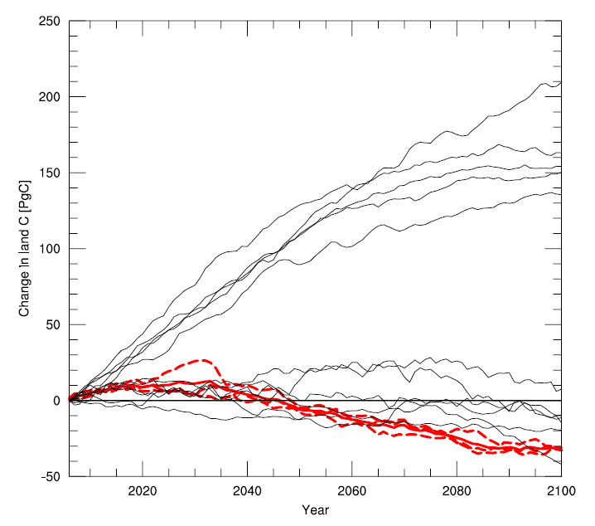
ACCESS-ESM1 carbon projections
Our ESM group are world leaders in modelling the effects of nutrient limitation on terrestrial carbon uptake.
Land carbon uptake for RCP2.6 case
Allowed emissions (fossil+land use) given diagnosed land and ocean carbon uptake
RCP8.5
RCP4.5
Black: CMIP5; Red: ACCESS-ESM1
ACCESS-ESM1 includes nitrogen and phosphorus limitation on carbon uptake
At the low end of CMIP5 range (thus lower allowed emissions).
RCP2.6
RCP2.6 requires negative emissions from about 2050.
Notes:
Almost all CMIP5 models do not have nutrient limitation

Slide 22
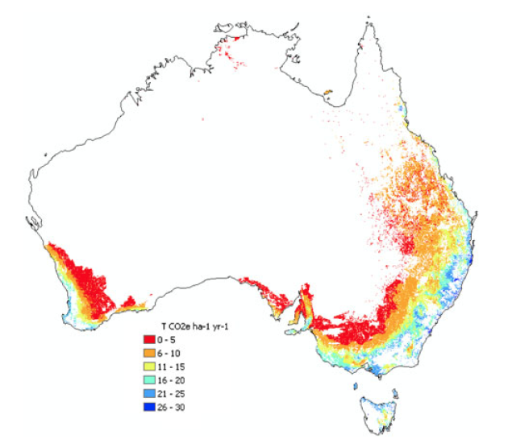
Australian emissions reduction target – Effectiveness of carbon abatement initiatives
Current methodology: Forest stand growth modelling
Rates of carbon sequestration averaged over 20 years masked by cleared land area (Polglase et al. 2013).
What is missing?
Change in soil carbon stocks✔
Coupling to water cycle✔
Response to changing climate✔
Response to CO₂✔
Response to disturbance, including fire✔
Drought-stress mortality✔
CABLE-based system for Australian assessment (BIOS)
✔ BIOS2
✔ BIOS3
Notes:
Current available information to estimate the potential for carbon sequestration in Australia is based on a forestry model which does a good job on aboveground biomass of forest. However, the vegetation estimates are insensitive to the CO2 fertilization effect of the rising of atmospheric CO2, it is not coupled to the water cycle to understand the water cost of massive reforestation, it deosn’t respond to a future changing climate. Our CABLE australia modeling capability can address all of these key processes to a better constrain the sequestration potential. (what is already know bios2)
In addition, we are developing the capacity to include both disturbances, including fire, and mortality from drought-stress (what we will call bios3)

Slide 23
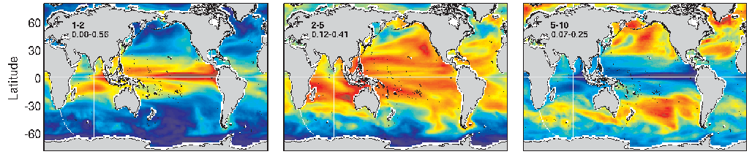
Multi-year/decadal prediction
Proportion of sea surface height variance for period 1-2 years
Bureau (Luo lead)
Set of 3 year hindcasts – case studies
Initialisation as for seasonal prediction
Initially use Met Office initial conditions
Later our local assimilation and ensemble generation scheme
Use ACCESS-S system
Proportion of sea surface height variance for period 5-10 years
CSIRO (O’Kane lead)
Focus on the longer time scales (several – 10 years)
Initialisation will use existing assimilation (BODAS) plus a newly developed ensemble generation code focusing on the dominant growing modes relevant to long time scales.
Use ACCESS-CM2 (N96O.25)
Notes:
Case studies e.g., El Nino to La Nina transition periods.
dominant growing modes - These modes have a strong signature in the sub-tropics/mid latutudes.

Slide 24
ACCESS: Regional climate modelling
ACCESS capability in high-resolution climate modelling
High resolution global atmospheric modelling (currently ~40 km, 25 km planned)
Limited area modelling, with implementation of scale-selective spectral nudging underway
Progress has been gradual due to limited resources and coordination issues
Met Office initiative
New focus on convective scale RCM (~1.5 km grid)
Team of 3-4 FTE being established at Met Office
Will become part of the regular UM releases
Stronger basis for an enhanced ACCESS RCM development
Would have synergy with the ACCESS-C limited area model for NWP
Significant preparation of CABLE for convective scale modelling already done
24
Notes:
High res global atmosphere ……
Time slice using sea surface temperature from lower resolution coupled runs

